Slide 1

Ruby on Rails

Slide 2
About today…
Ruby on Rails
Performance Optimization

Slide 3
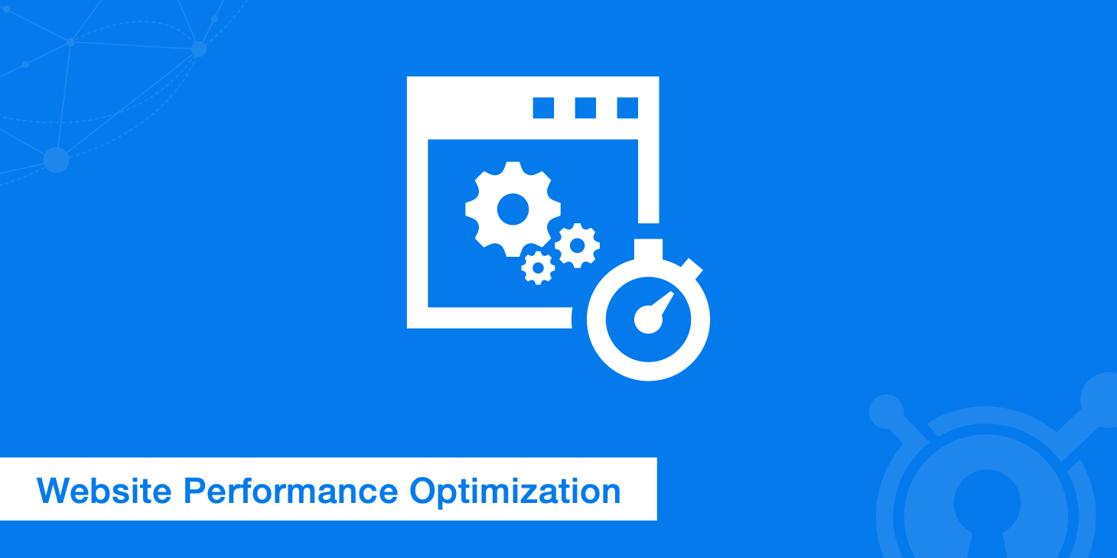
Importance of

Slide 4
Intro to Performance Optimization
Importance
Faster response times improve user experience
Better performance can lead to higher user retention
Efficient applications scale better and reduce infrastructure costs
Common Areas to Optimize
Database interactions
Application code efficiency
Caching mechanisms

Slide 5
Identifying Performance Bottlenecks
Common Performance Issues
Slow database queries causing delays
Inefficient code leading to high CPU and memory usage
Inadequate caching resulting in repeated computations
Tools for Identifying Bottlenecks
New Relic
Monitors application performance and provides detailed insights
Skylight
Analyzes performance issues and suggests improvements
Scout
Offers detailed metrics on request performance and resource usage

Slide 6

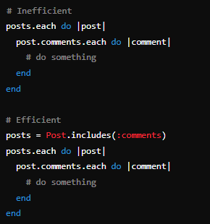
Optimizing Database Queries
Use of Indexes
Importance of Indexes
Speed up query performance by allowing faster data retrieval
How to Add Indexes in Rails
Use includes and joins
Avoiding N+1 Query Problem
Explanation
Occurs when an application makes multiple
database calls instead of a single efficient one
Database Query Optimization Tools
Bullet Gem
Identifies N+1 queries and unused eager loading
rack-mini-profiler
Analyzes and optimizes Active Record queries

Slide 7
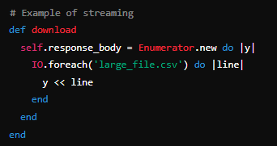
Improving Application Code
Code Refactoring
Importance of Clean Code
Makes the codebase maintainable and improves performance
DRY Principle
Avoid duplication to reduce code complexity
Use includes and joins
Object Allocation Best Practices
Reuse objects and avoid unnecessary object creation
Using Streaming for Large Data Sets

Slide 8

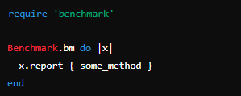
Improving Application Code
(contd…)
Use of Memoization
Cache results of expensive function calls
Benchmarking and Profiling Code
Measure performance to identify slow parts

Slide 9

Enhancing Caching Strategies
Types of Caching
Page Caching
Action Caching
Fragment Caching
Caches entire pages
Caches the output of controller actions
Caches parts of views
Implementing Caching in Rails
Cache Method
Cache Stores
MemoryStore
FileStore
Memcached
Redis
Stores cache in memory
Stores cache in files
Caches parts of views
In-memory data structure store
Best Practices for Caching
Cache Expiration and Invalidation
Avoiding Stale Data
Ensure cache is updated when data changes
Regularly update or invalidate cache

Slide 10
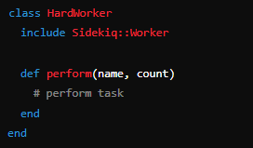
Leveraging Background Jobs
Importance of Background Jobs
Offloading Long-Running Tasks
Moves intensive tasks out of the main request cycle
Offloading Long-Running Tasks
Immediate response to user while task runs in the background
Popular Background Job Libraries
Sidekiq
Uses threads for parallel processing
Delayed Job
Processes jobs in the background
Resque
Uses Redis to manage background jobs
Implementing Background Jobs
Example Code with Sidekiq

Slide 11
Monitoring and Profiling Tools
Monitoring Application Performance
New Relic
Provides detailed performance metrics and error tracking
Skylight
Offers actionable insights into performance issues
AppSignal
Comprehensive monitoring for errors and performance
Profiling Tools for Ruby
Rack Mini Profiler
Inline request-response cycle performance profiling
RubyProf
A fast profiler for Ruby code
StackProf
A sampling call-stack profiler for Ruby

Slide 12


Slide 13

Why is performance optimization important for a Ruby on Rails application?
Faster response times improve user experience, better performance can lead to higher user retention
What are common areas to optimize in a Ruby on Rails application?
Database interactions, application code efficiency, and caching mechanisms
Name two common performance issues in Ruby on Rails applications
Slow database queries and inefficient code
How does adding indexes to a database help with performance?
Indexes speed up query performance by allowing faster data retrieval
Name three types of caching used in Ruby on Rails.
Page caching, action caching, and fragment caching
Why are background jobs important in a Rails application?
Background jobs offload long-running tasks out of the main request cycle, improving user response time

